Slide 1
Employee Data Analysis using Excel
STUDENT NAME: S. GOPI KRISHNAN
REGISTER NO: 312212638
DEPARTMENT: BCOM (General)
COLLEGE: Chennai National Arts And Science College

Slide 2
PROJECT TITLE
Employee Performance Analysis using Excel

Slide 3


AGENDA
Problem Statement
Project Overview
End Users
Our Solution and Proposition
Dataset Description
Modelling Approach
Results and Discussion
Conclusion
3/21/2024 Annual Review

Slide 4

PROBLEM STATEMENT
In the Organization to give for his achievements and able to focus on the Growth belongs to the employee performance and it is help to their personal growth for the employee motivation they will be promotion and increments we need to do this employee data analysis.

Slide 5

PROJECT OVERVIEW
Analysis the performance of the employee by considering various factors like gender, performance code, rating and their achievements its all based on the employee performance analysis . In order to identify the trends and patterns of different category of employee like High, Medium, low. This is while analysis the performance of the employee and organization growth.

Slide 6

WHO ARE THE END USERS?
Employee performance analysis will uses and benefit to an organization of employes, employer, various IT sector, industries so it will benefit to other management sector, Etc.

Slide 7

OUR SOLUTION AND ITS VALUE PROPOSITION
Conditional formatting - It uses for the missing value to be hilted
Filter - filter uses for missing value remove or filter out
Formula - it is calculated for the employee performance
Pivot table – it is uses for summary
Graph – Graph uses for the data visualization

Slide 8
Dataset Description
Employee data set :
1. Kaggle
2.26 features are there
3.9 features are taken
4.Employee id in numerical
5.first name and last name in text
6.performance level
7. Gender: male and female
8.Employee rating in numerical.

Slide 9

THE "WOW" IN OUR SOLUTION
It’s an new Idea for the calculation of the Employee analysis performance level
1.PERFORMANCE LEVEL: =IFS(Z8>=5,”VERY HIGH”,Z8>=4,”HIGH”,Z8=3,”MED”,TRUE,”LOW”)
9

Slide 10
MODELLING
DATA COLLECTION:
1) From gaggle downloaded data
2) Edunet foundation download the data sheet
Data Cleaning:
1) Find out the missing value
2) To filter out the missing value
Performance value:
1) It is calculated by employee performance
Summary:
1) Going to pivotable and finalize the graph
Visualization:
1) employee can finalize and calculate this as male or female employee performance.
10

Slide 11
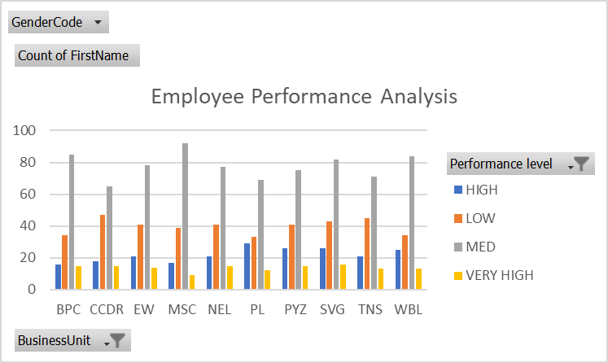
RESULTS
11

Slide 12
conclusion
The Employee performance analysis that the average number of employee is higher more in organization and we need to motivate them and the employee performance is standard level they need to perform better by giving task and work to be in high level performance for developing the organization. That’s performance analysis has shown in various organization.

